Slide 1

Employee Churn Management

Slide 2





Employee Churn Management
Business Challenge
Business Challenge
With the war on talent intensifying, this company is facing increasing turnover and challenges in retaining its key talent throughout the organization. Turnover is costly to the company’s financial performance. On average, the lost productivity and time it takes to hire, train and ramp up a new employee can cost anywhere between 90 – 200% of the departed employee’s salary.
A HR Department has been tasked with using a data driven approach to prepare next years hiring plans as well as implementing a new talent retention strategy. The Business users in HR want to get answers to these business questions:
How many employees are at risk per region, country, level, role?
What is the profile of the employees at risk?
How is it possible to retain some of these employees, at what cost?
What will be the budget for the next year hiring plan?
Solution
The Business users from the HR department use SAP Analytics Cloud Smart features to create and share stories and predictive scenarios (classification) to understand the factors that lead to employee churn, and predict which employees and how many could leave the company.
Benefits
The benefits of building SAC stories with augmented analytics will allow the HR Department and line managers to:
Gain more insight into what is causing people to leave the company
Reduce employee turnover by proactively reaching out to select ”At-Risk” employees
Create more accurate hiring plans based on input from employee turnover predictions
Industries
☑ Energy & Utilities
☑ CPG & Retail
Healthcare
Transportation
☑ Manufacturing
☑ Financial services & Insurance
Agriculture
☑ Chemical & Pharma
☑ New Technologies
Construction
☑ Defense & Aerospace
Education
☑ Sports & Entertainment
Mining
Telecommunications
☑ Government & Administration
SAC Features
Solution
SAC BI
SAC Smart Predict ◻ SAC Planning
Distribution Channel Direct, Partners
Benefits
Customer Segment All organizations with a large number of employees (5.000)
Department: Human Resources
Notes:
In this use case we see how the combination of predictive modelling and a standard SAC story can be used by a HR Department to detect how many employees in each category could leave the company, to target to try and retain some of them, and to prepare future hiring plans.
Smart Predict analyze historical data of an identified population and calculate for every employee his/her probability to leave the company. In the story, the employees at risk are aggregated depending on their category to deliver clear information that can be used directly to prepare the future.
The combination of Predictive and Business Intelligence allows HR managers to anticipate how many employees will leave, and make better decisions about which categories of employees to target to increase the value returned for their investment.
Secure achievement of goals in terms of turnover.
Anticipate total cost of hiring.
Lower cost per hire up to 20% when processes for creating & tracking jobs opening posting are automated.

Slide 3

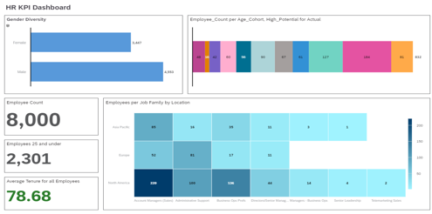
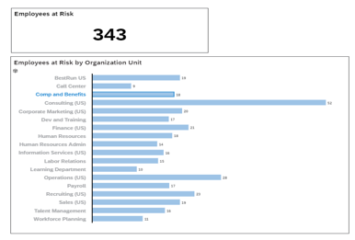
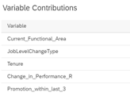
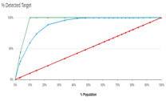






Employee Analysis for Churn Detection Process
1. Acquire data from external source
Acquire historical employee data as a dataset from external source.
3. Create predictive scenario
Create Predictive Scenarios to detect employees who are likely to leave the company.
5. Create augmented BI story
Create augmented BI stories to analyze and understand employee profiles.
1
2
3
4
5
6
2. Run Smart Assist features
Build a simple initial story, and run Smart Assist features (Search to Insight, Smart Discovery, Smart Insight, Smart Grouping), to discover hidden patterns for employee churn.
4. Control quality of Predictive Model
Control the quality of the predictive models created in the predictive scenario. Refine the datasets if necessary and retrain the models. Jump to step 5 only if Predictive Power and Predictive Confidence are acceptable.
6. Build & share dedicated business stories
Build BI stories to share with business users from other departments:
HR department prepares hiring plans.
Finance department anticipates costs of hiring.
All departments manage the risk of employee churn.

Slide 4







Value Proposition for Human Resources Managers
Classic BI / Data Discovery Cannot meet all expectations
SAC combines 3 Smart Functions to help business users to uncover hidden information and build augmented stories
Limited Insight – BI and dashboards do not show the hidden correlations contained in the data. The HR Analyst can only analyze simple data points to detect which employees are at risk of leaving.
Search to Insight – For example, Natural language enables business users to identify who are the top of employees in the company what profile of an employee that’s likely to leave.
Too Much Complexity – Data science requires deep knowledge, and an HR Analyst does not have the skillset to integrate complex rules, and the statistical model into their BI solutions.
Smart Discovery – Then, Smart Discovery can automatically build stories embedded with statistical insights that show what are the Key Drivers that lead to Employee Churn.
Resource Unavailability – Data scientists are high in demand and do not have time to assist the HR Analysts with their simplest needs. Existing solutions are too complex for business users.
Smart Predict – Once the HR analyst understand the global profile of the “At-Risk” employees, they can build a Machine Learning model that will rank employees based on probability of leaving the company.
As result, less than 20% of business users and data analysts use advanced analytics.
50% or more of advanced analytics to be done by non-data scientists – Gartner
Notes:
Smart Predict – Once the business user understands the global profile of these customers, they can build a machine learning model to profile and predict the behavior of each and every customer.

Slide 5
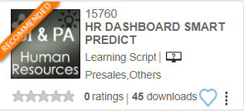
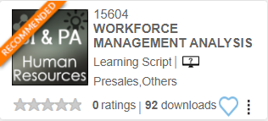
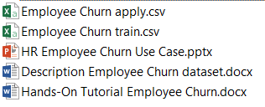
NOTES
DEMO STORE
DEMO PACKAGE

